Slide 1



Program Analyses using Newton's Method
Thomas Reps University of Wisconsin and GrammaTech, Inc.

Slide 2
Sidestepping Undecidability
Reachable States
Bad States
Universe of States

Slide 3
Sidestepping Undecidability
Overapproximate the reachable states
Reachable States
Bad States
False positive!
Universe of States
Notes:
. . . which can be portrayed as I’ve shown here.

Slide 4
Big Picture: Dataflow Analysis
Program
Abstraction engine
System of Dataflow Equations
In this work, we combine two methods for solving equations to create an improved equation solver
Equation solver
Solution (= dataflow facts)
Notes:
In terms of a typical system for program analysis, which has the pipeline shown on this slide, the algorithm plays the role of the equation solver. It takes as input the equation system that abstracts the actions of the program, and produces as output the solution to the equation system. That solution is then used to identify possible program flaws, or to establish the correctness of the program’s behavior.
<CLICK>
In essence, what we did was to combine two known techniques to create an improved equation solver.

Slide 5
Story in a Nutshell
In 1981, Tarjan found a fast way to solve intraprocedural dataflow equations
Solves a linear system of equations
In 2008, Esparza et al. used inspiration from Newton’s Method to solve interprocedural dataflow equations
Repeatedly: create and solve a linear system of equations
Esparza et al. and Tarjan do not create the same type of linear system
Cannot apply Tarjan’s algorithm to Esparza et al.’s linear systems
In 2016, Reps et al. found a way to transform Esparza et al.’s linear systems so that Tarjan’s algorithm can be applied
Surprising because a reasonable-sounding sanity check suggests that such a transformation is not possible!
Notes:
. . . Our result is surprising because, as I hope to convince you in the remainder of the talk, a reasonable-sounding sanity check suggest that what we were trying to do was impossible! But the moral is that sometimes a sanity check is only a plausible argument, and does not actually reflect reality.

Slide 6
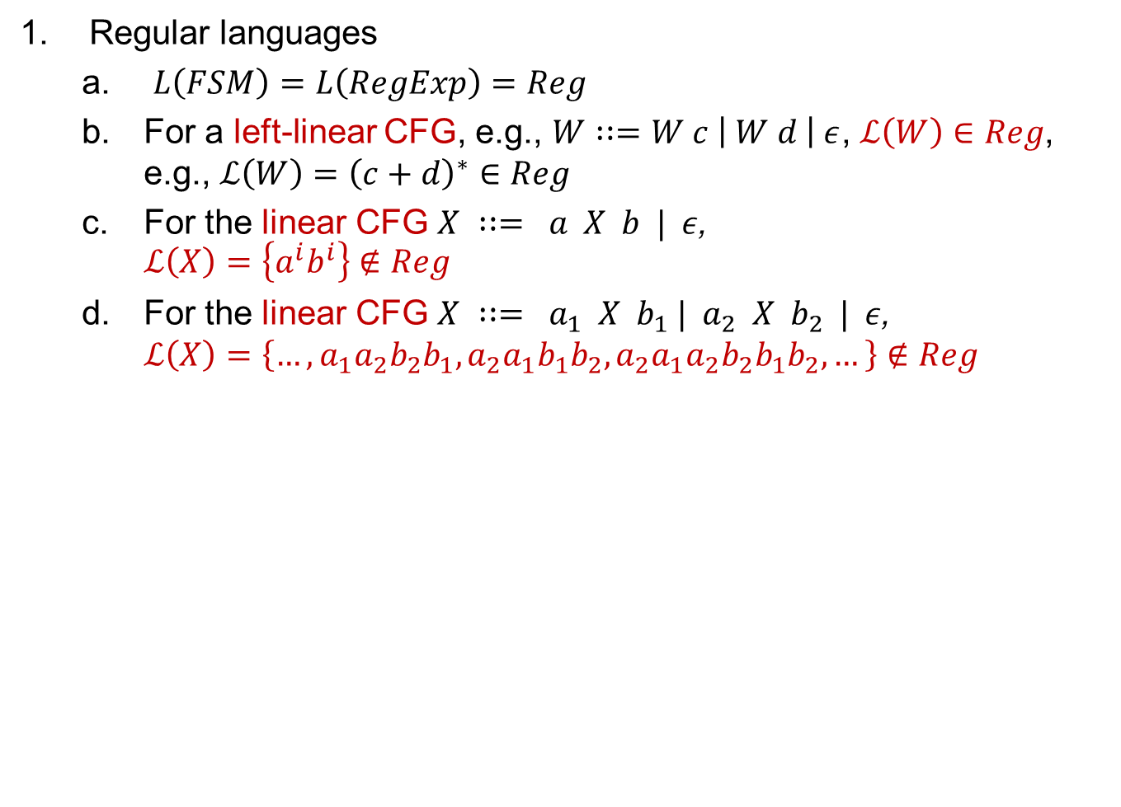
Five Pieces of General CS Knowledge
Regular languages
$L\left(FSM\right)=L\left(RegExp\right)=Reg$
For a left-linear CFG, e.g., $W∷=W c \left| W d \right| ε$, $ℒ\left(W\right)∈Reg$, e.g., $ℒ\left(W\right)={\left(c+d\right)}^{∗}∈Reg$
For the linear CFG $X ∷= a X b | ε$, $ℒ\left(X\right)=\left\{a^{i}b^{i}\right\}∉Reg$
For the linear CFG $X ∷= a_{1} X b_{1} | a_{2} X b_{2} | ε$, $ℒ\left(X\right)=\left\{…,a_{1}a_{2}b_{2}b_{1}, a_{2}a_{1}b_{1}b_{2},a_{2}a_{1}a_{2}b_{2}b_{1}b_{2},…\right\}∉Reg$

Slide 7

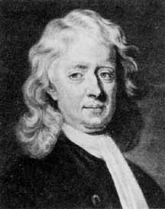
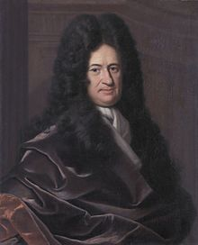
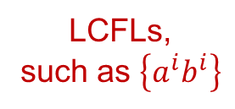
Ingredients of the Story
Regular
languages
LCFLs,
such as $\left\{a^{i}b^{i}\right\}$
Isaac
Newton
Gottfried
Wilhelm
Leibniz

Slide 8
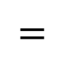
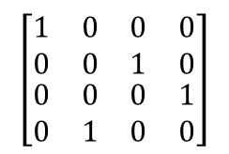
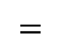
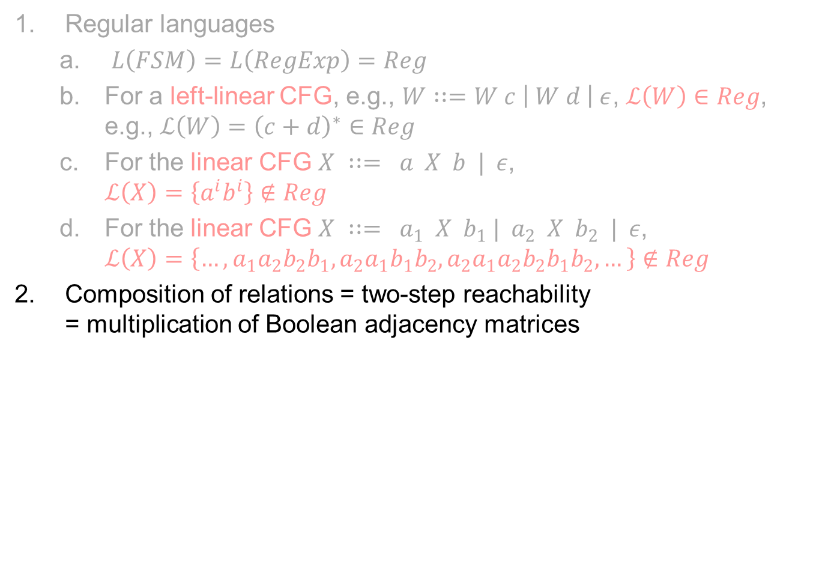

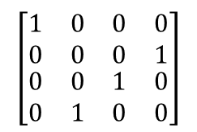
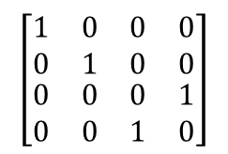
Five Pieces of General CS Knowledge
Regular languages
$L\left(FSM\right)=L\left(RegExp\right)=Reg$
For a left-linear CFG, e.g., $W∷=W c \left| W d \right| ε$, $ℒ\left(W\right)∈Reg$, e.g., $ℒ\left(W\right)={\left(c+d\right)}^{∗}∈Reg$
For the linear CFG $X ∷= a X b | ε$, $ℒ\left(X\right)=\left\{a^{i}b^{i}\right\}∉Reg$
For the linear CFG $X ∷= a_{1} X b_{1} | a_{2} X b_{2} | ε$, $ℒ\left(X\right)=\left\{…,a_{1}a_{2}b_{2}b_{1}, a_{2}a_{1}b_{1}b_{2},a_{2}a_{1}a_{2}b_{2}b_{1}b_{2},…\right\}∉Reg$
Composition of relations = two-step reachability = multiplication of Boolean adjacency matrices
$$A\left(P,P^{′}\right)⊗B\left(Q,Q^{′}\right)= ∃P^{′},Q. (A\left(P,P^{′}\right)∧B(Q,Q^{′})∧\left(P^{′}=Q\right))$$
$$=$$
$$\left[\begin{matrix}\begin{matrix}1 & 0 \\ 0 & 0\end{matrix} & \begin{matrix}0 & 0 \\ 0 & 1\end{matrix} \\ \begin{matrix}0 & 0 \\ 0 & 1\end{matrix} & \begin{matrix}1 & 0 \\ 0 & 0\end{matrix}\end{matrix}\right]$$
$$\left[\begin{matrix}\begin{matrix}1 & 0 \\ 0 & 1\end{matrix} & \begin{matrix}0 & 0 \\ 0 & 0\end{matrix} \\ \begin{matrix}0 & 0 \\ 0 & 0\end{matrix} & \begin{matrix}0 & 1 \\ 1 & 0\end{matrix}\end{matrix}\right]$$
$$\left[\begin{matrix}\begin{matrix}1 & 0 \\ 0 & 0\end{matrix} & \begin{matrix}0 & 0 \\ 1 & 0\end{matrix} \\ \begin{matrix}0 & 0 \\ 0 & 1\end{matrix} & \begin{matrix}0 & 1 \\ 0 & 0\end{matrix}\end{matrix}\right]$$
$$×$$
$$=$$

Slide 9
Outline
Background on dataflow analysis
Functional approach to interprocedural analysis
Newtonian program analysis
Newtonian program analysis via tensor product

Slide 10
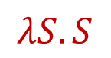
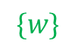
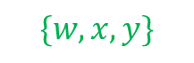

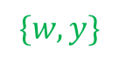

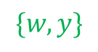
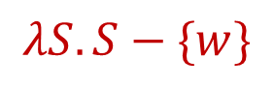
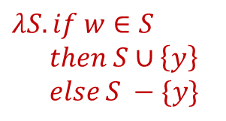
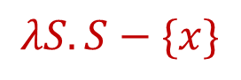
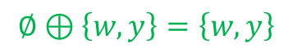

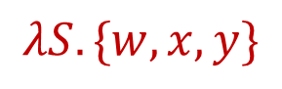
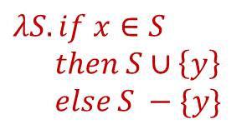
Possibly Uninitialized Variables (PUV)
“May Contain Junk”
$$∅$$
Start
$$λS.\{w,x,y\}$$
$$\{w,x,y\}$$
x = 3
$$λS.S−\{x\}$$
if . . .
$$\{w,y\}$$
$$λS.S$$
$$λS.S$$
y = x
$$\{w,y\}$$
$$λS.if x∈S$$
$$then S∪\left\{y\right\}$$
$$else S −\{y\}$$
$$\{w,y\}$$
y = w
$$λS.if w∈S$$
$$then S∪\left\{y\right\}$$
$$else S −\{y\}$$
w = 8
$$\{w\}$$
$$λS.S−\{w\}$$
printf(y)
$$∅⊕\left\{w,y\right\}=\left\{w,y\right\}$$

Slide 11

Possibly Uninitialized Variables (PUV)
“May Contain Junk”
$$∅$$
Start
Reachable States
$$λS.\{w,x,y\}$$
$$\{w,x,y\}$$
x = 3
$$λS.S−\{x\}$$
if . . .
$$\{w,y\}$$
$$λS.S$$
$$λS.S$$
y = x
$$\{w,y\}$$
$$λS.if x∈S$$
$$then S∪\left\{y\right\}$$
$$else S −\{y\}$$
$$\{w,y\}$$
y = w
$$λS.if w∈S$$
$$then S∪\left\{y\right\}$$
$$else S −\{y\}$$
w = 8
$$\{w\}$$
$$λS.S−\{w\}$$
printf(y)
$$∅⊕\left\{w,y\right\}=\left\{w,y\right\}$$

Slide 12
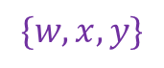
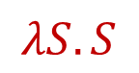
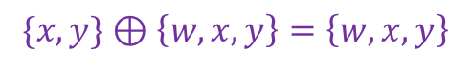
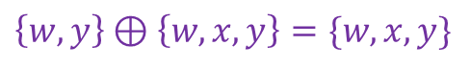

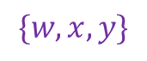
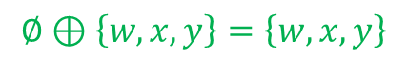

Possibly Uninitialized Variables (PUV)
“May Contain Junk”
$$∅$$
Start
$$λS.\{w,x,y\}$$
$$\{w,x,y\}$$
x = 3
$$λS.S−\{x\}$$
if . . .
$$\left\{w,y\right\}⊕\left\{w,x,y\right\}=\{w,x,y\}$$
$$\{w,y\}$$
$$λS.S$$
$$λS.S$$
y = x
$$\{w,x,y\}$$
$$λS.if x∈S$$
$$then S∪\left\{y\right\}$$
$$else S −\{y\}$$
$$\{w,y\}$$
$$\{w,y\}$$
x = w
$$\{w,x,y\}$$
$$λS.if w∈S$$
$$then S∪\left\{x\right\}$$
$$else S −\{x\}$$
w = 8
$$\{w\}$$
$$\{w,x,y\}$$
$$λS.S−\{w\}$$
$$λS.S$$
printf(y)
$$\{x,y\}⊕\left\{w,x,y\right\}=\left\{w,x,y\right\}$$
$$∅⊕\left\{w,x,y\right\}=\left\{w,x,y\right\}$$

Slide 13
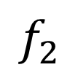
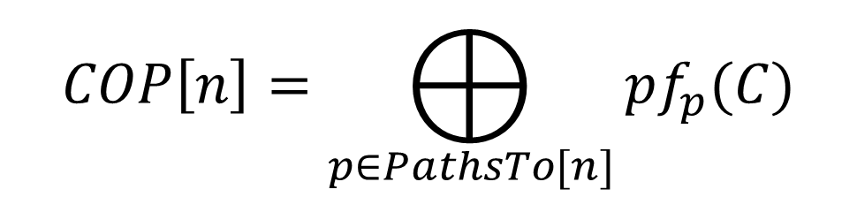
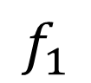
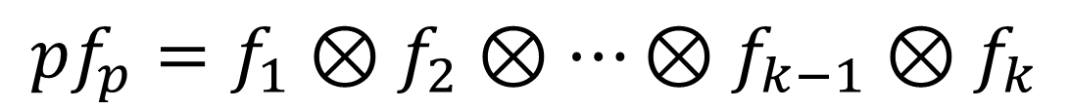
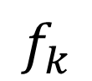
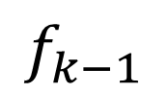
Path Semantics for Intraprocedural Analysis
C
$$f_{1}$$
$$f_{2}$$
$$f_{k−1}$$
$$f_{k}$$
start
n
$$pf_{p}=f_{1}⊗f_{2}⊗…⊗f_{k−1}⊗f_{k}$$
$$COP\left[n\right]=⨁_{p∈PathsTo[n]}{pf_{p}(C)}$$

Slide 14
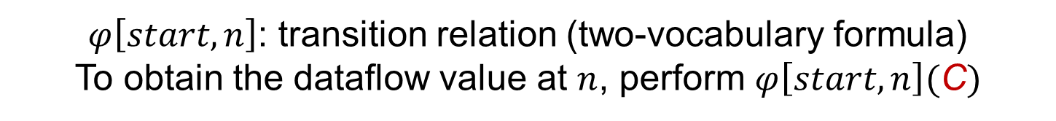
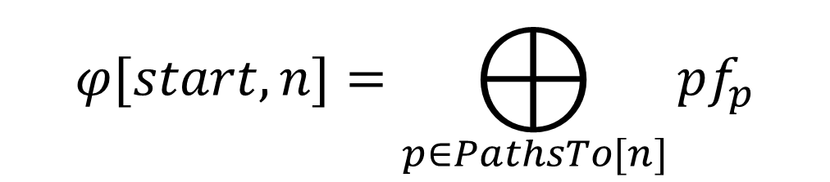
Path Semantics for Intraprocedural Analysis
C
$$f_{1}$$
$$f_{2}$$
$$f_{k−1}$$
$$f_{k}$$
start
n
$$pf_{p}=f_{1}⊗f_{2}⊗…⊗f_{k−1}⊗f_{k}$$
$$φ[start,n]=⨁_{p∈PathsTo[n]}{pf_{p}}$$
$φ\left[start,n\right]$: transition relation (two-vocabulary formula)
To obtain the dataflow value at $n$, perform $φ\left[start,n\right](\text{C})$

Slide 15

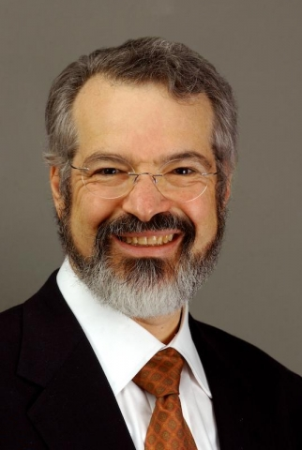
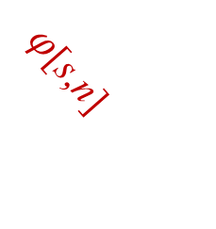
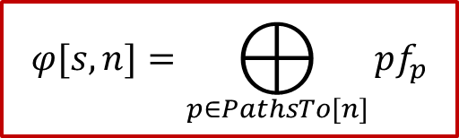
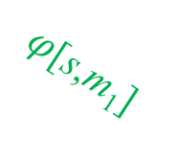

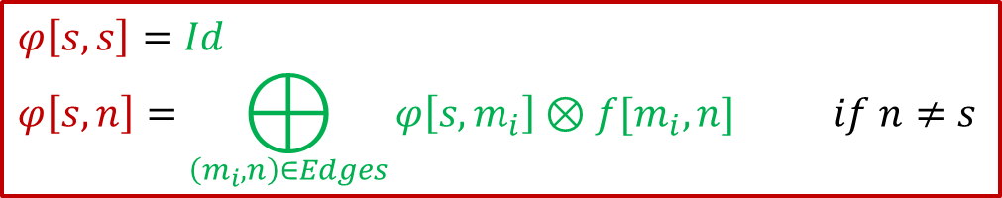
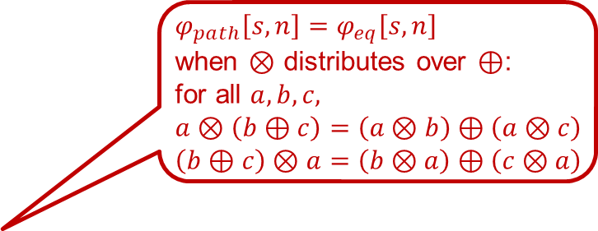
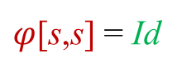
From Path Semantics to Equational Semantics
$φ_{path}\left[s,n\right]=φ_{eq}\left[s,n\right]$
when $⊗$ distributes over $⊕$:
for all $a,b,c,$
$a⊗\left(b⊕c\right)=\left(a⊗b\right)⊕\left(a⊗c\right)$
$\left(b⊕c\right)⊗a=\left(b⊗a\right)⊕\left(c⊗a\right)$
$$φ[s,n]=⨁_{p∈PathsTo[n]}{pf_{p}}$$
Path semantics:
$$φ\left[s,s\right]=Id$$
$$φ\left[s,n\right]=⨁_{\left(m_{i},n\right)∈Edges}{φ\left[s,m_{i}\right]⊗f[m_{i},n] } if n≠s$$
Equational semantics:
s
x
s
x
$φ$[s,m₁]
m₁
$φ$[s,n]
$φ$[s,s] = Id
$φ$[s,m_{k}]
. . .
f[m₁,n]
⊕
m_{k}
n
f[m_{k},n]
Susan
Graham
Mark
Wegman

Slide 16
Outline
Background on dataflow analysis
Functional approach to interprocedural analysis
Newtonian program analysis
Newtonian program analysis via tensor product

Slide 17
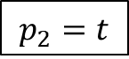
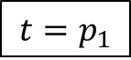
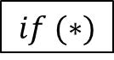

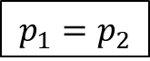

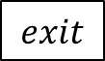
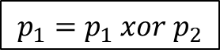
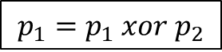
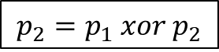
Swap Procedure
start
$$if (∗)$$
void swap(bool p₁, bool p₂) {
if (*) {
bool t = p₁;
p₁ = p₂;
p₂ = t;
}
else {
p₁ = p₁ ^ p₂;
p₂ = p₁ ^ p₂;
p₁ = p₁ ^ p₂;
}
}
$$t=p_{1}$$
$$p_{1}=p_{1} xor p_{2}$$
$$p_{1}=p_{2}$$
$$p_{2}=p_{1} xor p_{2}$$
$$p_{2}=t$$
$$p_{1}=p_{1} xor p_{2}$$
$$⊕$$
$$φ[start,exit]$$
$$exit$$
Procedure summary for swap()
Notes:
The family of phi functions that play a particularly important role in this talk are those from start to exit; these phi functions summarize all paths through the function and act as procedure summaries.

Slide 18











“Inter” Becomes “Intra” When Procedure Summaries are in Hand
s
x
P
$$c_{1}$$
$$r_{1}$$
$$c_{2}$$
$$r_{2}$$
$$In_{1}$$
$$Out_{1}$$
$$In_{2}$$
$$Out_{2}$$
$$s′$$
$$φ[s^{′},x^{′}]$$
$$x′$$

Slide 19


“Inter” Becomes “Intra” When Procedure Summaries are in Hand
s
x
P
$$c_{1}$$
$$r_{1}$$
$$c_{2}$$
$$r_{2}$$
$$In_{1}⊗φ\left[s^{′},x^{′}\right]⊗Out_{1}$$
$$In_{2}⊗φ\left[s^{′},x^{′}\right]⊗Out_{2}$$
$∴$ Now can solve using any intraprocedural method

Slide 20

Problem Statement
Given a collection of possibly recursive procedures $P=\{P_{i}\}$, and an abstract semantics, i.e.,
a transformer on each edge of each control-flow graph
extend ($⊗$) and combine ($⊕$) operations,
find a procedure summary for each $P_{i}∈P$

Slide 21
Swap Procedure
start
$$if (∗)$$
void swap(bool p₁, bool p₂) {
if (*) {
bool t = p₁;
p₁ = p₂;
p₂ = t;
}
else {
p₁ = p₁ ^ p₂;
p₂ = p₁ ^ p₂;
p₁ = p₁ ^ p₂;
}
}
$$t=p_{1}$$
$$p_{1}=p_{1} xor p_{2}$$
$$p_{1}=p_{2}$$
$$p_{2}=p_{1} xor p_{2}$$
$$p_{2}=t$$
$$p_{1}=p_{1} xor p_{2}$$
$$exit$$

Slide 22








Predicate Abstraction (Boolean Programs)
pre-state
assignment
$$(p_{1},p_{2})$$
post-state
assignment
$$(p_{1}^{′},p_{2}^{′})$$
(00)
(00)
(00)
(00)
(00)
(00)
(01)
(01)
(01)
(01)
(01)
(01)
(10)
(10)
(10)
(10)
(10)
(10)
(11)
(11)
(11)
(11)
(11)
(11)
$$p_{1}≔p_{1 }xor p_{2}$$
$$p_{2}≔p_{1 }xor p_{2}$$
$$p_{1}≔p_{1 }xor p_{2}$$
$$\left[\begin{matrix}\begin{matrix}1 & 0 \\ 0 & 0\end{matrix} & \begin{matrix}0 & 0 \\ 0 & 1\end{matrix} \\ \begin{matrix}0 & 0 \\ 0 & 1\end{matrix} & \begin{matrix}1 & 0 \\ 0 & 0\end{matrix}\end{matrix}\right]$$
$$\left[\begin{matrix}\begin{matrix}1 & 0 \\ 0 & 1\end{matrix} & \begin{matrix}0 & 0 \\ 0 & 0\end{matrix} \\ \begin{matrix}0 & 0 \\ 0 & 0\end{matrix} & \begin{matrix}0 & 1 \\ 1 & 0\end{matrix}\end{matrix}\right]$$
$$\left[\begin{matrix}\begin{matrix}1 & 0 \\ 0 & 0\end{matrix} & \begin{matrix}0 & 0 \\ 0 & 1\end{matrix} \\ \begin{matrix}0 & 0 \\ 0 & 1\end{matrix} & \begin{matrix}1 & 0 \\ 0 & 0\end{matrix}\end{matrix}\right]$$

Slide 23








Predicate Abstraction (Boolean Programs)
(00)
(00)
(00)
(00)
(00)
(00)
(01)
(01)
(01)
(01)
(01)
(01)
(10)
(10)
(10)
(10)
(10)
(10)
(11)
(11)
(11)
(11)
(11)
(11)
$$p_{1}≔p_{1 }xor p_{2}$$
$$p_{2}≔p_{1 }xor p_{2}$$
$$p_{1}≔p_{1 }xor p_{2}$$
$$\left[\begin{matrix}\begin{matrix}1 & 0 \\ 0 & 0\end{matrix} & \begin{matrix}0 & 0 \\ 0 & 1\end{matrix} \\ \begin{matrix}0 & 0 \\ 0 & 1\end{matrix} & \begin{matrix}1 & 0 \\ 0 & 0\end{matrix}\end{matrix}\right]$$
$$\left[\begin{matrix}\begin{matrix}1 & 0 \\ 0 & 1\end{matrix} & \begin{matrix}0 & 0 \\ 0 & 0\end{matrix} \\ \begin{matrix}0 & 0 \\ 0 & 0\end{matrix} & \begin{matrix}0 & 1 \\ 1 & 0\end{matrix}\end{matrix}\right]$$
$$\left[\begin{matrix}\begin{matrix}1 & 0 \\ 0 & 0\end{matrix} & \begin{matrix}0 & 0 \\ 0 & 1\end{matrix} \\ \begin{matrix}0 & 0 \\ 0 & 1\end{matrix} & \begin{matrix}1 & 0 \\ 0 & 0\end{matrix}\end{matrix}\right]$$
(00)
(00)
(01)
(01)
(10)
(10)
(11)
(11)
$$p_{1}≔p_{1 }xor p_{2};p_{2}≔p_{1 }xor p_{2}$$
$$\left[\begin{matrix}\begin{matrix}1 & 0 \\ 0 & 0\end{matrix} & \begin{matrix}0 & 0 \\ 1 & 0\end{matrix} \\ \begin{matrix}0 & 0 \\ 0 & 1\end{matrix} & \begin{matrix}0 & 1 \\ 0 & 0\end{matrix}\end{matrix}\right]$$

Slide 24


Predicate Abstraction (Boolean Programs)
(00)
(00)
(00)
(00)
(00)
(00)
(00)
(00)
(01)
(01)
(01)
(01)
(01)
(01)
(01)
(01)
(10)
(10)
(10)
(10)
(10)
(10)
(10)
(10)
(11)
(11)
(11)
(11)
(11)
(11)
(11)
(11)
$$p_{1}≔p_{1 }xor p_{2}$$
$$p_{2}≔p_{1 }xor p_{2}$$
$$p_{1}≔p_{1 }xor p_{2}$$
$$swap(p_{1},p_{2})$$
$$\left[\begin{matrix}\begin{matrix}1 & 0 \\ 0 & 0\end{matrix} & \begin{matrix}0 & 0 \\ 0 & 1\end{matrix} \\ \begin{matrix}0 & 0 \\ 0 & 1\end{matrix} & \begin{matrix}1 & 0 \\ 0 & 0\end{matrix}\end{matrix}\right]$$
$$\left[\begin{matrix}\begin{matrix}1 & 0 \\ 0 & 1\end{matrix} & \begin{matrix}0 & 0 \\ 0 & 0\end{matrix} \\ \begin{matrix}0 & 0 \\ 0 & 0\end{matrix} & \begin{matrix}0 & 1 \\ 1 & 0\end{matrix}\end{matrix}\right]$$
$$\left[\begin{matrix}\begin{matrix}1 & 0 \\ 0 & 0\end{matrix} & \begin{matrix}0 & 0 \\ 0 & 1\end{matrix} \\ \begin{matrix}0 & 0 \\ 0 & 1\end{matrix} & \begin{matrix}1 & 0 \\ 0 & 0\end{matrix}\end{matrix}\right]$$
(00)
(00)
(01)
(01)
(10)
(10)
(11)
(11)
$$p_{1}≔p_{1 }xor p_{2};p_{2}≔p_{1 }xor p_{2};p_{1}≔p_{1 }xor p_{2}$$
$$\left[\begin{matrix}\begin{matrix}1 & 0 \\ 0 & 0\end{matrix} & \begin{matrix}0 & 0 \\ 1 & 0\end{matrix} \\ \begin{matrix}0 & 1 \\ 0 & 0\end{matrix} & \begin{matrix}0 & 0 \\ 0 & 1\end{matrix}\end{matrix}\right]$$

Slide 25
Swap Procedure
start
$$if (∗)$$
void swap(bool p₁, bool p₂) {
if (*) {
bool t = p₁;
p₁ = p₂;
p₂ = t;
}
else {
p₁ = p₁ ^ p₂;
p₂ = p₁ ^ p₂;
p₁ = p₁ ^ p₂;
}
}
$$t=p_{1}$$
$$p_{1}=p_{1} xor p_{2}$$
$$p_{1}=p_{2}$$
$$p_{2}=p_{1} xor p_{2}$$
$$p_{2}=t$$
$$p_{1}=p_{1} xor p_{2}$$
(00)
(00)
?
(01)
(01)
$$exit$$
(10)
(10)
(11)
(11)

Slide 26








Predicate Abstraction (Boolean Programs)
pre-state
assignment
$$(p_{1},p_{2},t)$$
post-state
assignment
$$(p_{1}^{′},p_{2}^{′},t′)$$
(000)
(000)
(000)
(000)
(000)
(000)
(001)
(001)
(001)
(001)
(001)
(001)
(010)
(010)
(010)
(010)
(010)
(010)
(011)
(011)
(011)
(011)
(011)
(011)
(100)
(100)
(100)
(100)
(100)
(100)
(101)
(101)
(101)
(101)
(101)
(101)
(110)
(110)
(110)
(110)
(110)
(110)
(111)
(111)
(111)
(111)
(111)
(111)
$$t≔p_{1}$$
$$p_{1}≔p_{2}$$
$$p_{2}≔t$$
$$\left[\begin{matrix}\begin{matrix}\begin{matrix}1 & 0 \\ 1 & 0\end{matrix} & \begin{matrix}0 & 0 \\ 0 & 0\end{matrix} \\ \begin{matrix}0 & 0 \\ 0 & 0\end{matrix} & \begin{matrix}1 & 0 \\ 1 & 0\end{matrix}\end{matrix} & \begin{matrix}\begin{matrix}0 & 0 \\ 0 & 0\end{matrix} & \begin{matrix}0 & 0 \\ 0 & 0\end{matrix} \\ \begin{matrix}0 & 0 \\ 0 & 0\end{matrix} & \begin{matrix}0 & 0 \\ 0 & 0\end{matrix}\end{matrix} \\ \begin{matrix}\begin{matrix}0 & 0 \\ 0 & 0\end{matrix} & \begin{matrix}0 & 0 \\ 0 & 0\end{matrix} \\ \begin{matrix}0 & 0 \\ 0 & 0\end{matrix} & \begin{matrix}0 & 0 \\ 0 & 0\end{matrix}\end{matrix} & \begin{matrix}\begin{matrix}0 & 1 \\ 0 & 1\end{matrix} & \begin{matrix}0 & 0 \\ 0 & 0\end{matrix} \\ \begin{matrix}0 & 0 \\ 0 & 0\end{matrix} & \begin{matrix}0 & 1 \\ 0 & 1\end{matrix}\end{matrix}\end{matrix}\right]$$
$$\left[\begin{matrix}\begin{matrix}\begin{matrix}1 & 0 \\ 0 & 1\end{matrix} & \begin{matrix}0 & 0 \\ 0 & 0\end{matrix} \\ \begin{matrix}0 & 0 \\ 0 & 0\end{matrix} & \begin{matrix}0 & 0 \\ 0 & 0\end{matrix}\end{matrix} & \begin{matrix}\begin{matrix}0 & 0 \\ 0 & 0\end{matrix} & \begin{matrix}0 & 0 \\ 0 & 0\end{matrix} \\ \begin{matrix}0 & 0 \\ 0 & 0\end{matrix} & \begin{matrix}1 & 0 \\ 0 & 1\end{matrix}\end{matrix} \\ \begin{matrix}\begin{matrix}1 & 0 \\ 0 & 1\end{matrix} & \begin{matrix}0 & 0 \\ 0 & 0\end{matrix} \\ \begin{matrix}0 & 0 \\ 0 & 0\end{matrix} & \begin{matrix}0 & 0 \\ 0 & 0\end{matrix}\end{matrix} & \begin{matrix}\begin{matrix}0 & 0 \\ 0 & 0\end{matrix} & \begin{matrix}0 & 0 \\ 0 & 0\end{matrix} \\ \begin{matrix}0 & 0 \\ 0 & 0\end{matrix} & \begin{matrix}1 & 0 \\ 0 & 1\end{matrix}\end{matrix}\end{matrix}\right]$$
$$\left[\begin{matrix}\begin{matrix}\begin{matrix}1 & 0 \\ 0 & 0\end{matrix} & \begin{matrix}0 & 0 \\ 0 & 1\end{matrix} \\ \begin{matrix}1 & 0 \\ 0 & 0\end{matrix} & \begin{matrix}0 & 0 \\ 0 & 1\end{matrix}\end{matrix} & \begin{matrix}\begin{matrix}0 & 0 \\ 0 & 0\end{matrix} & \begin{matrix}0 & 0 \\ 0 & 0\end{matrix} \\ \begin{matrix}0 & 0 \\ 0 & 0\end{matrix} & \begin{matrix}0 & 0 \\ 0 & 0\end{matrix}\end{matrix} \\ \begin{matrix}\begin{matrix}0 & 0 \\ 0 & 0\end{matrix} & \begin{matrix}0 & 0 \\ 0 & 0\end{matrix} \\ \begin{matrix}0 & 0 \\ 0 & 0\end{matrix} & \begin{matrix}0 & 0 \\ 0 & 0\end{matrix}\end{matrix} & \begin{matrix}\begin{matrix}1 & 0 \\ 0 & 0\end{matrix} & \begin{matrix}0 & 0 \\ 0 & 1\end{matrix} \\ \begin{matrix}1 & 0 \\ 0 & 0\end{matrix} & \begin{matrix}0 & 0 \\ 0 & 1\end{matrix}\end{matrix}\end{matrix}\right]$$

Slide 27






Predicate Abstraction (Boolean Programs)
(000)
(000)
(000)
(000)
(000)
(000)
(001)
(001)
(001)
(001)
(001)
(001)
(010)
(010)
(010)
(010)
(010)
(010)
(011)
(011)
(011)
(011)
(011)
(011)
(100)
(100)
(100)
(100)
(100)
(100)
(101)
(101)
(101)
(101)
(101)
(101)
(110)
(110)
(110)
(110)
(110)
(110)
(111)
(111)
(111)
(111)
(111)
(111)
$$t≔p_{1}$$
$$p_{1}≔p_{2}$$
$$p_{2}≔t$$
$$\left[\begin{matrix}\begin{matrix}\begin{matrix}1 & 0 \\ 1 & 0\end{matrix} & \begin{matrix}0 & 0 \\ 0 & 0\end{matrix} \\ \begin{matrix}0 & 0 \\ 0 & 0\end{matrix} & \begin{matrix}1 & 0 \\ 1 & 0\end{matrix}\end{matrix} & \begin{matrix}\begin{matrix}0 & 0 \\ 0 & 0\end{matrix} & \begin{matrix}0 & 0 \\ 0 & 0\end{matrix} \\ \begin{matrix}0 & 0 \\ 0 & 0\end{matrix} & \begin{matrix}0 & 0 \\ 0 & 0\end{matrix}\end{matrix} \\ \begin{matrix}\begin{matrix}0 & 0 \\ 0 & 0\end{matrix} & \begin{matrix}0 & 0 \\ 0 & 0\end{matrix} \\ \begin{matrix}0 & 0 \\ 0 & 0\end{matrix} & \begin{matrix}0 & 0 \\ 0 & 0\end{matrix}\end{matrix} & \begin{matrix}\begin{matrix}0 & 1 \\ 0 & 1\end{matrix} & \begin{matrix}0 & 0 \\ 0 & 0\end{matrix} \\ \begin{matrix}0 & 0 \\ 0 & 0\end{matrix} & \begin{matrix}0 & 1 \\ 0 & 1\end{matrix}\end{matrix}\end{matrix}\right]$$
$$\left[\begin{matrix}\begin{matrix}\begin{matrix}1 & 0 \\ 0 & 1\end{matrix} & \begin{matrix}0 & 0 \\ 0 & 0\end{matrix} \\ \begin{matrix}0 & 0 \\ 0 & 0\end{matrix} & \begin{matrix}0 & 0 \\ 0 & 0\end{matrix}\end{matrix} & \begin{matrix}\begin{matrix}0 & 0 \\ 0 & 0\end{matrix} & \begin{matrix}0 & 0 \\ 0 & 0\end{matrix} \\ \begin{matrix}0 & 0 \\ 0 & 0\end{matrix} & \begin{matrix}1 & 0 \\ 0 & 1\end{matrix}\end{matrix} \\ \begin{matrix}\begin{matrix}1 & 0 \\ 0 & 1\end{matrix} & \begin{matrix}0 & 0 \\ 0 & 0\end{matrix} \\ \begin{matrix}0 & 0 \\ 0 & 0\end{matrix} & \begin{matrix}0 & 0 \\ 0 & 0\end{matrix}\end{matrix} & \begin{matrix}\begin{matrix}0 & 0 \\ 0 & 0\end{matrix} & \begin{matrix}0 & 0 \\ 0 & 0\end{matrix} \\ \begin{matrix}0 & 0 \\ 0 & 0\end{matrix} & \begin{matrix}1 & 0 \\ 0 & 1\end{matrix}\end{matrix}\end{matrix}\right]$$
$$\left[\begin{matrix}\begin{matrix}\begin{matrix}1 & 0 \\ 0 & 0\end{matrix} & \begin{matrix}0 & 0 \\ 0 & 1\end{matrix} \\ \begin{matrix}1 & 0 \\ 0 & 0\end{matrix} & \begin{matrix}0 & 0 \\ 0 & 1\end{matrix}\end{matrix} & \begin{matrix}\begin{matrix}0 & 0 \\ 0 & 0\end{matrix} & \begin{matrix}0 & 0 \\ 0 & 0\end{matrix} \\ \begin{matrix}0 & 0 \\ 0 & 0\end{matrix} & \begin{matrix}0 & 0 \\ 0 & 0\end{matrix}\end{matrix} \\ \begin{matrix}\begin{matrix}0 & 0 \\ 0 & 0\end{matrix} & \begin{matrix}0 & 0 \\ 0 & 0\end{matrix} \\ \begin{matrix}0 & 0 \\ 0 & 0\end{matrix} & \begin{matrix}0 & 0 \\ 0 & 0\end{matrix}\end{matrix} & \begin{matrix}\begin{matrix}1 & 0 \\ 0 & 0\end{matrix} & \begin{matrix}0 & 0 \\ 0 & 1\end{matrix} \\ \begin{matrix}1 & 0 \\ 0 & 0\end{matrix} & \begin{matrix}0 & 0 \\ 0 & 1\end{matrix}\end{matrix}\end{matrix}\right]$$
(000)
(000)
(001)
(001)
(010)
(010)
(011)
(011)
(100)
(100)
(101)
(101)
(110)
(110)
(111)
(111)

Slide 28


Predicate Abstraction (Boolean Programs)
(000)
(000)
(000)
(000)
(000)
(000)
(001)
(001)
(001)
(001)
(001)
(001)
(010)
(010)
(010)
(010)
(010)
(010)
(011)
(011)
(011)
(011)
(011)
(011)
(100)
(100)
(100)
(100)
(100)
(100)
(101)
(101)
(101)
(101)
(101)
(101)
(110)
(110)
(110)
(110)
(110)
(110)
(111)
(111)
(111)
(111)
(111)
(111)
$$t≔p_{1}$$
$$p_{1}≔p_{2}$$
$$p_{2}≔t$$
$$\left[\begin{matrix}\begin{matrix}\begin{matrix}1 & 0 \\ 1 & 0\end{matrix} & \begin{matrix}0 & 0 \\ 0 & 0\end{matrix} \\ \begin{matrix}0 & 0 \\ 0 & 0\end{matrix} & \begin{matrix}1 & 0 \\ 1 & 0\end{matrix}\end{matrix} & \begin{matrix}\begin{matrix}0 & 0 \\ 0 & 0\end{matrix} & \begin{matrix}0 & 0 \\ 0 & 0\end{matrix} \\ \begin{matrix}0 & 0 \\ 0 & 0\end{matrix} & \begin{matrix}0 & 0 \\ 0 & 0\end{matrix}\end{matrix} \\ \begin{matrix}\begin{matrix}0 & 0 \\ 0 & 0\end{matrix} & \begin{matrix}0 & 0 \\ 0 & 0\end{matrix} \\ \begin{matrix}0 & 0 \\ 0 & 0\end{matrix} & \begin{matrix}0 & 0 \\ 0 & 0\end{matrix}\end{matrix} & \begin{matrix}\begin{matrix}0 & 1 \\ 0 & 1\end{matrix} & \begin{matrix}0 & 0 \\ 0 & 0\end{matrix} \\ \begin{matrix}0 & 0 \\ 0 & 0\end{matrix} & \begin{matrix}0 & 1 \\ 0 & 1\end{matrix}\end{matrix}\end{matrix}\right]$$
$$\left[\begin{matrix}\begin{matrix}\begin{matrix}1 & 0 \\ 0 & 1\end{matrix} & \begin{matrix}0 & 0 \\ 0 & 0\end{matrix} \\ \begin{matrix}0 & 0 \\ 0 & 0\end{matrix} & \begin{matrix}0 & 0 \\ 0 & 0\end{matrix}\end{matrix} & \begin{matrix}\begin{matrix}0 & 0 \\ 0 & 0\end{matrix} & \begin{matrix}0 & 0 \\ 0 & 0\end{matrix} \\ \begin{matrix}0 & 0 \\ 0 & 0\end{matrix} & \begin{matrix}1 & 0 \\ 0 & 1\end{matrix}\end{matrix} \\ \begin{matrix}\begin{matrix}1 & 0 \\ 0 & 1\end{matrix} & \begin{matrix}0 & 0 \\ 0 & 0\end{matrix} \\ \begin{matrix}0 & 0 \\ 0 & 0\end{matrix} & \begin{matrix}0 & 0 \\ 0 & 0\end{matrix}\end{matrix} & \begin{matrix}\begin{matrix}0 & 0 \\ 0 & 0\end{matrix} & \begin{matrix}0 & 0 \\ 0 & 0\end{matrix} \\ \begin{matrix}0 & 0 \\ 0 & 0\end{matrix} & \begin{matrix}1 & 0 \\ 0 & 1\end{matrix}\end{matrix}\end{matrix}\right]$$
$$\left[\begin{matrix}\begin{matrix}\begin{matrix}1 & 0 \\ 0 & 0\end{matrix} & \begin{matrix}0 & 0 \\ 0 & 1\end{matrix} \\ \begin{matrix}1 & 0 \\ 0 & 0\end{matrix} & \begin{matrix}0 & 0 \\ 0 & 1\end{matrix}\end{matrix} & \begin{matrix}\begin{matrix}0 & 0 \\ 0 & 0\end{matrix} & \begin{matrix}0 & 0 \\ 0 & 0\end{matrix} \\ \begin{matrix}0 & 0 \\ 0 & 0\end{matrix} & \begin{matrix}0 & 0 \\ 0 & 0\end{matrix}\end{matrix} \\ \begin{matrix}\begin{matrix}0 & 0 \\ 0 & 0\end{matrix} & \begin{matrix}0 & 0 \\ 0 & 0\end{matrix} \\ \begin{matrix}0 & 0 \\ 0 & 0\end{matrix} & \begin{matrix}0 & 0 \\ 0 & 0\end{matrix}\end{matrix} & \begin{matrix}\begin{matrix}1 & 0 \\ 0 & 0\end{matrix} & \begin{matrix}0 & 0 \\ 0 & 1\end{matrix} \\ \begin{matrix}1 & 0 \\ 0 & 0\end{matrix} & \begin{matrix}0 & 0 \\ 0 & 1\end{matrix}\end{matrix}\end{matrix}\right]$$
(000)
(000)
(00)
(00)
(001)
(001)
(01)
(01)
(010)
(010)
exit scope
(10)
(10)
(011)
(011)
(11)
(11)
(100)
(100)
$$swap(p_{1},p_{2})$$
(101)
(101)
(110)
(110)
$$\left[\begin{matrix}\begin{matrix}1 & 0 \\ 0 & 0\end{matrix} & \begin{matrix}0 & 0 \\ 1 & 0\end{matrix} \\ \begin{matrix}0 & 1 \\ 0 & 0\end{matrix} & \begin{matrix}0 & 0 \\ 0 & 1\end{matrix}\end{matrix}\right]$$
(111)
(111)

Slide 29
Swap Procedure
start
$$if (∗)$$
void swap(bool p₁, bool p₂) {
if (*) {
bool t = p₁;
p₁ = p₂;
p₂ = t;
}
else {
p₁ = p₁ ^ p₂;
p₂ = p₁ ^ p₂;
p₁ = p₁ ^ p₂;
}
}
$$t=p_{1}$$
$$p_{1}=p_{1} xor p_{2}$$
$$p_{1}=p_{2}$$
$$p_{2}=p_{1} xor p_{2}$$
$$p_{2}=t$$
$$p_{1}=p_{1} xor p_{2}$$
(00)
(00)
$$⊕$$
(00)
(00)
(01)
(01)
(01)
(01)
(10)
(10)
$$exit$$
(10)
(10)
$$φ[start,exit]$$
(11)
(11)
(11)
(11)
(00)
(00)
Procedure summary for swap()
(01)
(01)
(10)
(10)
(11)
(11)

Slide 30


From Path Semantics to Equational Semantics
$$φ[s,n]=⨁_{p∈PathsTo[n]}{pf_{p}}$$
Path semantics:
$$φ\left[s,s\right]=Id$$
$$φ\left[s,n\right]=⨁_{\left(m_{i},n\right)∈Edges}{φ\left[s,m_{i}\right]⊗f[m_{i},n] } if n≠s$$
Equational semantics:
s
x
s
x
$φ$[s,m₁]
m₁
$φ$[s,n]
$φ$[s,s] = Id
$φ$[s,m_{k}]
. . .
f[m₁,n]
⊕
m_{k}
n
f[m_{k},n]
Susan
Graham
Mark
Wegman

Slide 31










Interprocedural Equational Semantics
s
x
$$φ\left[s,s\right]=Id$$
$$φ\left[s,n\right]=⨁_{\left(m_{i},n\right)∈Edges}{φ\left[s,m_{i}\right]⊗f[m_{i},n] } if n≠s$$
$$φ\left[s,r\right]=φ\left[s,c\right]⊗In_{c,s^{′}}⊗φ\left[s^{′},x^{′}\right]⊗Out_{x^{′},r}$$
$φ$[s,s] = Id
$$s$$
$$x$$
s
x
$φ$[s,m₁]
$$φ[s,c]$$
$$φ[s,r]$$
m₁
$φ$[s,n]
c
r
$φ$[s,m_{k}]
. . .
f[m₁,n]
$$In_{c,s′}$$
$$Out_{x^{′},r}$$
⊕
$$s′$$
$$x′$$
m_{k}
n
$$φ[s^{′},x^{′}]$$
f[m_{k},n]

Slide 32






Conventional Approach to Summary Functions
Set up equation system:
$φ\left[s,s\right]=Id for all s∈StartNodes$
$$φ\left[s,n\right]=⨁_{\left(m_{i},n\right)∈Edges}{φ\left[s,m_{i}\right]⊗f[m_{i},n] } for all s∈StartNodes∧n∉StartNodes$$
$φ\left[s,r\right]=φ\left[s,c\right]⊗In_{c,s^{′}}⊗φ\left[s^{′},x^{′}\right]⊗Out_{x^{′},r} for all \left(c,r\right)∈CallSites∧\left(c,s^{′}\right)∈Calls$
Summary for called procedure
Summary for call site
Solve using successive approximation
(Kleene evaluation or chaotic iteration)
Micha
Sharir
Amir
Pnueli
Patrick
Cousot
Radhia
Cousot
$$\vec{⊥}$$

Slide 33
Outline
Background on dataflow analysis
Functional approach to interprocedural analysis
Newtonian program analysis
Newtonian program analysis via tensor product

Slide 34
Big Picture: Dataflow Analysis
Program
Abstraction engine
System of Dataflow Equations
NPA: An alternative equation solver for finding procedure summaries
Equation solver
Solution (dataflow facts; procedure summaries)
Notes:
In terms of a typical system for program analysis, which has the pipeline shown on this slide, the algorithm plays the role of the equation solver. It takes as input the equation system that abstracts the actions of the program, and produces as output the solution to the equation system. That solution is then used to identify possible program flaws, or to establish the correctness of the program’s behavior.
<CLICK>
In essence, what we did was to combine two known techniques to create an improved equation solver.

Slide 35

Newton’s Method for Finding Roots
y
A way to find successively better approximations of a root of a function
Given a function f, its derivative f’ and an initial x₀, repeatedly perform $x_{i+1}=x_{i} − \frac{f\left(x_{i}\right)}{f^{′}\left(x_{i}\right)}$
f(x_{i})
f(x_{i+1})
x
x_{i+2}
x_{i+1}
x_{i}
Newtonian Program Analysis: The same general idea—repeatedly create and solve a linear model—can be applied to programs, too
Create a linear model of the function and use it to find a better approximation of the solution
Isaac
Newton
Notes:
Brief overview of Newton’s method – for Calculus. (Motivates why it is proper to call the method of Esparza et al. a variation on Newton’s method.)

Slide 36


Newton’s Method for Programs
Kleene iteration
${\vec{ν}}^{(0)}= \vec{⊥}$
$${\vec{ν}}^{(i+1)}= \vec{f}({\vec{ν}}^{(i)})$$
NPA iteration
${ \vec{ν}}^{(0)} = \vec{⊥}$
$${\vec{ν}}^{(i+1)}= \vec{f}\left({\vec{ν}}^{\left(i\right)}\right)⊕LinearCorrectionTerm\left(\vec{f}, {\vec{ν}}^{(i)}\right)$$
$$\vec{⊥}$$
Notes:
In program analysis, we typically use iterative algorithms, such as Kleene iteration, which works up a lattice to find a fixed point. The so-called Newtonian Program Analysis of Esparza, Luttenberger, and Kiefer is based on the observation that numerical analysts also use iterative algorithms, but instead of something like Kleene iteration, they use Newton’s method. I’ll say more about this over the next few slides, but the high-level picture is that NPA is quite similar to Kleene iteration, except that there is an adjustment made each round in the form of some linear correction term, which has the effect of reducing the number of iterative rounds that need to be performed.

Slide 37




Newton’s Method for Programs
Kleene iteration
${\vec{ν}}^{(0)}= \vec{⊥}$
$${\vec{ν}}^{(i+1)}= \vec{f}({\vec{ν}}^{(i)})$$
NPA iteration
${ \vec{ν}}^{(0)} = \vec{⊥}$
$${\vec{ν}}^{(i+1)}= \vec{f}\left({\vec{ν}}^{\left(i\right)}\right)⊕LinearCorrectionTerm\left(\vec{f}, {\vec{ν}}^{(i)}\right)$$
$$\vec{⊥}$$
Non-numeric equations with a commutative multiplication
Numeric equations
from probabilistic
programs
Mark
Hopkins
Dexter
Kozen
Kousha
Etessami
Mihalis
Yannakakis
37
Notes:
In program analysis, we typically use iterative algorithms, such as Kleene iteration, which works up a lattice to find a fixed point. So-called Newtonian Program Analysis is based on the observation that numerical analysts also use iterative algorithms, but instead of something like Kleene iteration, they use Newton’s method. I’ll say more about this over the next few slides, but the high-level picture is that NPA is quite similar to Kleene iteration, except that there is an adjustment made each round in the form of some linear correction term, which has the effect of reducing the number of iterative rounds that need to be performed.

Slide 38



Newton’s Method for Programs
Kleene iteration
${\vec{ν}}^{(0)}= \vec{⊥}$
$${\vec{ν}}^{(i+1)}= \vec{f}({\vec{ν}}^{(i)})$$
NPA iteration
${ \vec{ν}}^{(0)} = \vec{⊥}$
$${\vec{ν}}^{(i+1)}= \vec{f}\left({\vec{ν}}^{\left(i\right)}\right)⊕LinearCorrectionTerm\left(\vec{f}, {\vec{ν}}^{(i)}\right)$$
$$\vec{⊥}$$
Non-numeric equations
from interprocedural
dataflow analysis:
non-commutative multiplication
Javier
Esparza
Michael
Luttenberger
Stefan
Kiefer
38

Slide 39

Newton’s Method for Program Analysis [Esparza et al.]
Esparza et al. had to finesse certain differences
Real-valued equations → Algebraic semiring
Root finding versus fixed-point finding?
Derivatives?
Mathematics | Program Analysis
Multiplication: x | Abstract Compose: $⨂$
Addition: + | Join: $⨁$
Notes:
To bring out the analogy, we’ll use the semiring formulation of dataflow-analysis problems.
This formulation is really just a change in nomenclature: dataflow problems are equations over a formal multiplication operator and a formal sum operator. The semiring values are abstract transformers of exactly the kind used in interprocedural dataflow analysis, namely abstractions of the program’s transition functions: multiplication is just an abstraction of function composition; and plus is
what is more commonly called join.

Slide 40


Polynomial Equations for Summary Functions
proc X₁
proc X₂
x₁() {
a;
x₂();
}
x₂() {
if (*) d;
else{
b;
x₂();
x₂();
c;
}
}
a
b
X₂
X₂
d
X₂
X₂
c
Equation System
$$X_{1}=a ⨂ X_{2}$$
$X_{2}=d ⨁$ $b ⨂ X_{2}⨂X_{2}⨂c_{ }$
Notes:
Here is a program that I’ll use as a running example.
Each summand represents a path in the (acyclic) control-flow graph.
Esparza et al. handle loops by assuming that all loops have been converted to calls on tail-recursive procedures. In general, they have a precise method for solving systems of recursive, loop-free equations. One of the contributions of our paper that I will not talk about in this presentation is a different method for handling loops that does not rely on such a normalizing transformation.

Slide 41

Polynomial Equations for Summary Functions
proc X₁
proc X₂
x₁() {
a;
x₂();
}
x₂() {
if (*) d;
else{
b;
x₂();
x₂();
c;
}
}
a
b
X₂
X₂
d
X₂
c
Equation System
This term is quadratic
$$X_{1}=a ⨂ X_{2}$$
$X_{2}=d ⨁$ $b ⨂ X_{2}⨂X_{2}⨂c_{ }$
Notes:
If we go back to the running example, we see that we have a quadratic equation system because of the two calls along one branch of procedure X₂

Slide 42



Problematic Issues . . .
We have no minus operation in dataflow analysis ☹
$f(x) = x$ → $f\left(x\right)−x=0$
What the heck do we do about $f^{′}\left(⋅\right)?$ 😐
$$x_{i+1}=x_{i} − \frac{f\left(x_{i}\right)}{f^{′}\left(x_{i}\right)}$$
Notes:
Esparza et al. had to finesse a couple of problems.
We might try to reduce our fixed-point problem to a root-finding problem merely by subtracting x from both sides;
however, this approach is a non-starter because we have no minus operation in dataflow analysis
Then if you look at the iteration step, it has a derivative in it. What the heck do we do about that?

Slide 43








Newton’s Method for Programs [Esparza et al.]
Leibniz
product
rule
Finesse the derivative question by fiat:
$D\left(g⊕h\right)=Dg⊕Dh$
$D\left(g⊗h\right)=\left(Dg⊗h\right)⊕\left(g⊗Dh\right)$
Gottfried Wilhelm
Leibniz
Outer fixpoint computation
NPA iteration
${\vec{ν}}^{(0)} =$ $\vec{f}(\vec{0})$
$${\vec{ν}}^{(i+1)}= {\vec{Y}}^{(i)}$$
where ${\vec{Y}}^{(i)}$ is the least solution of
$\vec{Y}$ = $\vec{f}\left({\vec{ν}}^{\left(i\right)}\right) ⊕ D\vec{f}|_{{\vec{ν}}^{\left(i\right)}}(\vec{Y})$
Really a differential: $f\left(X\right)\underset{⇒}{v}f^{′}\left(v\right)⊗Y$, modulo non-commutativity of $⊗$
0
$Y$
$Dg(X)|_{ν}\left(Y\right)⊕Dh(X)|_{ν}\left(Y\right)$
$\left(Dg(X)|_{ν}\left(Y\right)⊗h\left(ν\right)\right)⊕\left(g\left(ν\right)⊗Dh\left(X\right)|_{ν}\left(Y\right)\right)$
if $f(X)$ is a constant
if $f(X)=X$
if $f(X)=g(X)⊕h(X)$
if $f\left(X\right)=g\left(X\right)⊗h(X)$
$$Df(X)|_{ν}\left(Y\right)=$$
Inner fixpoint computation
Example 1: $X⊗X\underset{⇒}{v}\left(Y⊗v\right)⊕\left(v⊗Y\right)$
Linear correction term
Example 2: $b⊗X⊗X⊗c\underset{⇒}{v}\left(b⊗Y⊗v⊗c\right)⊕\left(b⊗v⊗Y⊗c\right)$

Slide 44








Polynomial Equations for Summary Functions
$y_{2}$ is the value of $Y_{2}$ from the previous Newton round – i.e., some constant for the current round
Differentiated equations
Original equations
Apply the
linearization
operator
$$Y_{1}= a⨂y_{2}$$
$⨁$ $a⨂Y_{2}$
$$X_{1}=a ⨂ X_{2}$$
y
$Y_{2}= d$
$X_{2}=d ⨁$ $b ⨂ X_{2}⨂X_{2}⨂c_{ }$
$$⨁ b⨂y_{2}⨂ y_{2}⨂ c$$
Each summand now only has one variable; this system of equations is linear!
$$⨁ b⨂y_{2}⨂ Y_{2}⨂ c$$
$$⨁ b⨂Y_{2}⨂ y_{2}⨂ c$$
proc X₁
proc X₂
f(x_{i})
a
b
X₂
X₂
x
d
x_{i+2}
x_{i+1}
x_{i}
X₂
c

Slide 45

Polynomial Equations for Summary Functions
Differentiated equations
Original equations
Apply the
linearization
operator
$$Y_{1}= a⨂y_{2}$$
$⨁$ $a⨂Y_{2}$
$$X_{1}=a ⨂ X_{2}$$
$Y_{2}= d$
$X_{2}=d ⨁$ $b ⨂ X_{2}⨂X_{2}⨂c_{ }$
$$⨁ b⨂y_{2}⨂ y_{2}⨂ c$$
$$⨁ b⨂y_{2}⨂ Y_{2}⨂ c$$
$$⨁ b⨂Y_{2}⨂ y_{2}⨂ c$$
Operational interpretation:
$y_{2}$ is the current approximation
At first call, use $y_{2}$; at second call, perform exploration (of the transformed procedure)
At first call, perform exploration (of the transformed procedure); at second call, use $y_{2}$
Combine ($⊕)$
proc X₁
proc X₂
proc Y₁
proc Y₂
a
b
a
a
b
b
b
X₂
X₂
y₂
Y₂
y₂
y₂
Y₂
d
d
X₂
y₂
Y₂
y₂
c
c
c
c

Slide 46










Goal: Precise Solution of Linear Equations
Pre-call action
Post-call action
start
exit
$$a_{p,k}$$
$$b_{p,k}$$
Matched path $p$
$$a_{p,2}$$
$$b_{p,2}$$
$$a_{p,1}$$
$$b_{p,1}$$
$$pf_{p}={a_{p,k}⊗…⊗a_{p,2}⊗a_{p,1}⊗b}_{p,1}⊗b_{p,2}⊗…⊗b_{p,k}$$
$={a_{p,k}…a_{p,2}a_{p,1}b}_{p,1}b_{p,2}…b_{p,k}$
$$φ\left[start,exit\right]=⨁_{p∈MatchedPathsTo\left[exit\right]}{pf_{p}}$$
$$=⨁_{p∈MatchedPathsTo[exit]}{{a_{p,k}…a_{p,2}a_{p,1}b}_{p,1}b_{p,2}…b_{p,k}}$$

Slide 47
Outline
Background on dataflow analysis
Functional approach to interprocedural analysis
Newtonian program analysis
Newtonian program analysis via tensor product

Slide 48
Big Picture: Dataflow Analysis
Program
Abstraction engine
System of Dataflow Equations
NPA-TP: Combines NPA with Tarjan’s method to create an improved NPA solver (for finding procedure summaries)
Equation solver
Solution (dataflow facts; procedure summaries)
Notes:
In terms of a typical system for program analysis, which has the pipeline shown on this slide, the algorithm plays the role of the equation solver. It takes as input the equation system that abstracts the actions of the program, and produces as output the solution to the equation system. That solution is then used to identify possible program flaws, or to establish the correctness of the program’s behavior.
<CLICK>
In essence, what we did was to combine two known techniques to create an improved equation solver.

Slide 49

A Misconception on My Part
Polynomial $→$ Linear
Interprocedural analysis $→$ Intraprocedural analysis
On each Newton round, use a fast intraprocedural solver, such as Tarjan’s path-expression method!
Notes:
This work got started due to a misconception on my part. We tried out Newtonian Program Analysis, and found that although it was true that there were very few rounds, each round took quite a long time performing Kleene iteration on each linear problem. I suggested that we try a fast intraprocedural method, namely, Tarjan’s path-expression method. I was surprised by my student’s answer, which was that there was an essential mismatch that prevented us from applying Tarjan’s method.

Slide 50


Tarjan’s Path-Expression Method
FSM-to-regular-expression conversion == the most-general dataflow-analysis problem
Dataflow analysis for a single control-flow graph (CFG)
(“intraprocedural analysis”)
For each $n∈Nodes$, find a regular expression $R_{n}$
CFG = finite-state machine over alphabet of edges
Convert FSM to a regular expression (Kleene’s theorem)
$R_{n}$ characterizes all paths from the start node to $n$
For each “client” analysis
Interpret each alphabet symbol as the abstract transformer of the corresponding CFG edge
Interpret +, $⋅$, and * using suitable operations $⊕$, $⊗$, and ⊛
Evaluate each $R_{n}$, $n∈Nodes$
Robert
Tarjan

Slide 51






A Misconception on My Part
Issue:
Extend ($⨂$) typically models the reversal of function composition: $f ⨂ g ≝g ○f$
In general, $⨂$is not commutative
In a semiring
$D\left(X^{2}\right)|_{ν}(Y)$ = $D\left(X⊗X\right)|_{ν}(Y)$
$=$ $D\left(X\right)|_{ν}\left(Y\right)⊗ν$
$⊕ν⊗D\left(X\right)|_{ν}\left(Y\right)$
$=$ $Y⊗ ν⊕ν  Y$
$≠$ $ν⊗Y⊕ν⊗Y$
In calculus
$D\left(X^{2}\right)|_{ν}(Y)$ = $D\left(X×X\right)|_{ν}(Y)$
$=$ $D\left(X\right)|_{ν}\left(Y\right) × ν$
$+$ $ν × D\left(X\right)|_{ν}\left(Y\right)$
$=$ $Y  ν+$ $ν  Y$
$=ν×Y+ν×Y$
$=2νY$
$$b⨂y_{2}⨂Y_{2}⨂c ≠Y_{2}⨂b⨂y_{2}⨂c$$
$$=2XdX$$
Esparza’s linear equations are not left-linear or right-linear, which Tarjan requires
$$≠b⨂y_{2}⨂c⨂Y_{2}$$

Slide 52





Doesn’t the Pumping Lemma Imply . . . Fuggedaboutit?
If we represent the Esparza linearized system as a grammar, we obtain a linear context-free grammar
$$Y_{1} ∷=ay2 | aY_{2}$$
$$Y_{2} ∷=d | by_{2}y_{2}c \left| bY_{2}y_{2}c \right| by_{2}Y_{2}c$$
One learns early on in a formal-language course that not all languages defined by a linear context-free grammar are regular
In particular, $\{ aibi | i N \}$ is the canonical example of an LCFL language that is not regular: X ::= a X b | ε
Suggests that we are barking up the wrong tree . . . ☹
Michael
Rabin
Dana
Scott
Notes:
. . . <Mirrored Symmetry> . . .

Slide 53

Sanity Check?
Tarjan’s
path-expression
method (a technique
based on Regular
languages)
LCFLs from NPA $∉$ Regular languages

Slide 54

Doesn’t the Pumping Lemma Imply . . . Fuggedaboutit?
If we represent the Esparza linearized system as a grammar, we obtain a linear context-free grammar
$$Y_{1} ∷=ay2 | aY_{2}$$
$$Y_{2} ∷=d | by_{2}y_{2}c \left| bY_{2}y_{2}c \right| by_{2}Y_{2}c$$
One learns early on in a formal-language course that not all languages defined by a linear context-free grammar are regular
In particular, $\{ aibi | i N \}$ is the canonical example of an LCFL language that is not regular: X ::= a X b | ε
Suggests that we are barking up the wrong tree . . . ☹
But we aren’t!
We are not abstracting the program to a grammar
We can sidestep the issue with some “magic”
from algebra ☺
Michael
Rabin
Dana
Scott
Notes:
. . . <Mirrored Symmetry> . . .

Slide 55

Converting to Tarjan
The challenge:
Devise a way to accumulate matching quantities on both the left and right sides
However, in a regular language, we can only accumulate values on one side
Suggests using pairs of values (lhs, rhs):
$Y_{1}= a⨂y_{2}$
$⨁$ $a⨂Y_{2}$
$Y_{2}= d$
$⨁ b⨂y_{2}⨂ y_{2}⨂ c$
$$⨁ b⨂y_{2}⨂ Y_{2}⨂ c$$
$⨁ b⨂Y_{2}⨂ y_{2}⨂ c$
becomes
$Z_{1}= (1,a⨂y_{2})$ ${ Y}_{1}=ℛ(Z_{1})$
$⊕_{p}Z_{2}⨂_{p}(a,1)$ ${ Y}_{2}=ℛ(Z_{2})$
$Z_{2}= (1,d)$
$${ ⊕}_{p}(1,b⨂y_{2}⨂y_{2}c)$$
$$⊕_{p}Z_{2}⨂_{p}(b⨂y_{2},c)$$
$$⊕_{p}Z_{2}⨂_{p}(b,y_{2}⨂c)$$
LCFL
Each variable occurrence is now leftmost in its summand; this system of equations is left-linear!
Left-recursive = Regular

Slide 56

Converting to Tarjan
The challenge:
Devise a way to accumulate matching quantities on both the left and right sides
However, in a regular language, we can only accumulate values on one side
Suggests using pairs of values (lhs, rhs):
$\left(a_{1},b_{1}\right){ ⊕}_{p}\left(a_{2},b_{2}\right)=_{df}\left(a_{1}⊕a_{2},b_{1}⊕b_{2}\right)$
$\left(a_{1},b_{1}\right){ ⨂}_{p}\left(a_{2},b_{2}\right)=_{df}\left(a_{2}⨂a_{1},b_{1}⨂b_{2}\right)$
Given a pair $\left(a,b\right)$, define the readout operation ℛ($\left(a,b\right))≝a⨂b$
Thus,
ℛ$(\left(a_{1},b_{1}\right)⨂_{p}\left(a_{2},b_{2}\right))=\text{ℛ}(\left(a_{1},b_{1}\right)⨂_{p}\left(a_{2},b_{2}\right))$
$=\text{ℛ}\text{(}\left(a_{2}⨂a_{1},b_{1}⨂b_{2}\right)$)
$=$ $a_{2}⨂a_{1}⨂b_{1}⨂b_{2}$
Notes:
. . . <Reversal in the paired multiplication operator> . . .
. . . <Mirrored Symmetry> . . .

Slide 57





Converting to Tarjan
The challenge:
Devise a way to accumulate matching quantities on both the left and right sides
However, in a regular language, we can only accumulate values on one side
$Y_{1}= a⨂y_{2}$
$⨁$ $a⨂Y_{2}$
$Y_{2}= d$
$⨁ b⨂y_{2}⨂ y_{2}⨂ c$
$$⨁ b⨂y_{2}⨂ Y_{2}⨂ c$$
$⨁ b⨂Y_{2}⨂ y_{2}⨂ c$
${ Z}_{1}= (1,a⨂y_{2})$ $Y_{1}=ℛ(Z_{1})$
${ ⊕}_{p}{ Z}_{2}⨂_{p}\left(a,1\right)$ ${ Y}_{2} = ℛ(Z_{2})$
$Z_{2}= (1,d)$
$${ ⊕}_{p} (1,b⨂y_{2}⨂y_{2}c)$$
$$⊕_{p}Z_{2}⨂_{p}(b⨂y_{2},c)$$
$$⊕_{p}Z_{2}⨂_{p}(b,y_{2}⨂c)$$
(3)
(3)
(1)
(1)
(2)
(2)
b
b
d
(1,d)
(b⊗y₂, c)
(b, y₂⊗c)
y₂
y₂
(1,d) ⊗$p$(b,y₂⊗c) ⊗$p$(b ⊗y₂,c)
ℛ((1,d) ⊗$p$(b,y₂⊗c) ⊗$p$(b ⊗y₂,c))
= ℛ(b ⊗y₂ ⊗b ⊗1, d ⊗y₂⊗c ⊗c)
= b ⊗y₂ ⊗b ⊗1⊗d ⊗y₂⊗c ⊗c
c
c
Notes:
This slide shows how the paired system simulates the computations of the original system

Slide 58



Pairing Fails to Deliver . . .
X₁ $=$ 1 X₂ $=$ a₁⊗X₁⊗b₁
⊕ a₂⊗X₁⊗b₂
Z₁ $=$ (1, 1) Z₂ $=$ Z₁ ⊗_{p} (a₁, b₁)
⊕_{p} Z₁ ⊗_{p} (a₂, b₂)
proc X₁
proc X₂
proc Z₁
proc X₂
1
a₁
a₂
(1,1)
Z₁
Z₁
X₁
X₁
(a₁, b₁)
(a₂,b₂)
b₁
b₂
Least solution (⊕_{p} of the two paths):
Z₂ $=$ (1,1) $⊗_{p}$ (a₁, b₁) ⊕_{p} (1,1) $⊗_{p}$ (a₂, b₂)
$=$ (a₁, b₁) ⊕_{p} (a₂, b₂)
$=\left(\text{a}\text{1}⊕\text{a}\text{2},\text{b}\text{1}⊕\text{b}\text{2}\right)$
ℛ((a₁⊕a₂, b₁⊕b₂)) = (a₁⊕a₂) ⊗ (b₁⊕b₂)
= a₁b₁ ⊕ a₂b₁ ⊕ a₁b₂ ⊕ a₂b₂
Conservative, but loses precision . . . ☹
Least solution (⊕ of the two paths):
X₂ = a₁⊗1⊗b₁ ⊕ a₂⊗1⊗b₂
= a₁b₁ ⊕ a₂b₂

Slide 59









Pairing Fails to Deliver . . . for PUV
proc X₁
proc Z₁
proc X₂
$$Λ a b c$$
int a,b,c;
void X₁() {
skip
}
void X₂() {
if (*) {
a = 3;
X₁();
c = a;
}
else {
b = 5;
X₁();
c = b;
}
}
$$Λ a b c$$
skip
(skip,skip)
Z₁
Z₁
(init; a = 3, c = a)
(init; b = 5, c = b)
$c$ is possibly uninitialized
proc X₂
$$Λ a b c$$
Z₂ = ℛ$( \text{(}\text{skip}\text{,}\text{skip}\text{)}⊗_{p}\text{(}\text{init}\text{; }\text{a}\text{ = 3, }\text{c}\text{ = }\text{a}\text{)}$
$$⊕_{p}\text{(}\text{skip}\text{,}\text{skip}\text{)}⊗_{p}\text{(}\text{init}\text{; }\text{b}\text{ = }\text{5}\text{, }\text{c}\text{ = }\text{b}\text{)}$$
$$)$$
= ℛ$(\text{(}\text{init}\text{; }\text{a}\text{ = 3, }\text{c}\text{ = }\text{a}\text{)}⊕_{p}\text{(}\text{init}\text{; }\text{b}\text{ = 5, }\text{c}\text{ = }\text{b}\text{)})$
= ℛ$(\text{init}\text{; }\text{a}\text{ = 3}⊕\text{init}\text{; }\text{b}\text{ = 5, }\text{c}\text{ = }\text{a}⊕\text{c}\text{ = }\text{b})$
= $\left(\text{init}\text{; }\text{a}\text{ = 3}⊕\text{init}\text{; }\text{b}\text{ = 5}\right)⊗\left(\text{c}\text{ = }\text{a}⊕\text{c}\text{ = }\text{b}\right)$
= init; $\text{a}\text{ = 3}⊗\text{c}\text{ = }\text{a}⊕\text{init}\text{; }\text{a}\text{ = 3}⊗\text{c}\text{ = }\text{b}$
$⊕\text{init}\text{; }\text{b}\text{ = }\text{5}⊗\text{c}\text{ = }\text{a}⊕\text{init}\text{; }\text{b}\text{ = }\text{5}⊗\text{c}\text{ = }\text{b}$
= $[[\text{init}\text{; }\text{a}\text{ = 3; }\text{c}\text{ = }\text{a}\text{]]}⊕\text{[[}\text{init}\text{; }\text{a}\text{ = 3; }\text{c}\text{ = }\text{b}\text{]]}$
$⊕\text{[[}\text{init}\text{; }\text{b}\text{ = 5; }\text{c}\text{ = }\text{a}\text{]]}⊕[[\text{init}\text{; }\text{b}\text{ = 5; }\text{c}\text{ = }\text{b}\text{]]}$
init
$$Λ a b c$$
$$Λ a b c$$
a = 3
b = 5
X₁
X₁
$$Λ a b c$$
$$Λ a b c$$
c = a
c = b
No path $Λ→^{∗}c$
$∴c$ is definitely initialized
$$Λ a b c$$
Least solution (⊕ of the two paths):
X₂ = [[init; a = 3; skip; c = a]]
⊕ [[init; b = 5; skip; c = b]]

Slide 60

Doesn’t the Pumping Lemma Imply . . . Fuggedaboutit?
If we represent the Esparza linearized system as a grammar, we obtain a linear context-free grammar
$$Y_{1} ∷=ay2 | aY_{2}$$
$$Y_{2} ∷=d | by_{2}y_{2}c \left| bY_{2}y_{2}c \right| by_{2}Y_{2}c$$
Fuggedaboutit?
One learns early on in a formal-language course that not all languages defined by a linear context-free grammar are regular
In particular, { a^{i}b^{i} | i ∈N } is the canonical example of an LCFL language that is not regular: X ::= a X b | ε
Suggests that we are barking up the wrong tree . . . ☹
Michael
Rabin
Dana
Scott
Notes:
. . . <Mirrored Symmetry> . . .

Slide 61

A Glimmer of Hope . . .
A transformation of the linearized problem to left-linear form is not actually forced to use pairing
From the pair $(a,b)$, we can recover $a$
From the pair $(a,b)$, we can recover $b$
Given a “coupled value” $c = couple(a, b)$, we never need to recover from $c$ the value of $a$ or $b$ alone
We only need to be able to obtain the value $a⊗b$
Pairing is overkill!
$⇒$ Use some kind of “blending” of $a$ and $b$
Notes:
So what saves us? Well, there is one glimmer of hope. We are not actually forced to use pairing per se. We need to produce some kind of coupled value; however, the property of pairing is that one can recover each individual argument from the pair, and we never have to do that.
You can think of a coupled value c as some kind of blending of a and b. It just has to be a blending from which we can recover “a extend b” later, if we so choose. One analogy is RSA public keys: the public key is a blending of two primes. In that case, you can extract the arguments, but not without doing a lot of work.

Slide 62


How to Blend Two Values, A and B
Hint: Kronecker product of matrices:
$A⨀B =\left[\begin{matrix}a_{1,1} & a_{1,2} \\ a_{2,1} & a_{2,2}\end{matrix}\right]⨀\left[\begin{matrix}b_{1,1} & b_{1,2} \\ b_{2,1} & b_{2,2}\end{matrix}\right]$
$=\left[\begin{matrix}a_{1,1}B & a_{1,2}B \\ a_{2,1}B & a_{2,2}B\end{matrix}\right]$
$=\left[\begin{matrix}\begin{matrix}a_{1,1}b_{1,1} & a_{1,1}b_{1,2} \\ a_{1,1}b_{2,1} & a_{1,1}b_{2,2}\end{matrix} & \begin{matrix}a_{1,2}b_{1,1} & a_{1,2}b_{1,2} \\ {a_{1,2}b}_{2,1} & a_{1,2}b_{2,2}\end{matrix} \\ \begin{matrix}a_{2,1}b_{1,1} & a_{2,1}b_{1,2} \\ a_{2,1}b_{2,1} & a_{2,1}b_{2,2}\end{matrix} & \begin{matrix}a_{2,2}b_{1,1} & a_{2,2}b_{1,2} \\ a_{2,2}b_{2,1} & a_{2,2}b_{2,2}\end{matrix}\end{matrix}\right]$
A?
B?
Leopold
Kronecker

Slide 63






Converting to Tarjan
We need a “magic” pairing operator, $couple\left(a,b\right)$, with the property
and a readout operator with the properties
$readout(couple\left(m,n\right))$ $=$ $m⨂n$
$$readout\left(c_{1}⊕c_{2}\right)=readout\left(c_{1}\right)⊕readout(c_{2})$$
Such a construction does not create cross-terms ⇒ no loss of precision
$couple\left(a_{1},b_{1}\right)⊗couple(a_{2},b_{2}) =couple(a_{2}⊗a_{1}, b_{1}⊗b_{2})$ (†)
$readout\left(couple\left(a_{1},b_{1}\right)⊕couple(a_{2}, b_{2})\right)$
$=readout\left(couple\left(a_{1},b_{1}\right)\right)⨁readout\left(couple(a_{2}, b_{2})\right)$
$= a_{1}b_{1}⨁a_{2}b_{2}$
versus
$ℛ\left(\left(a_{1},b_{1}\right){ ⨁}_{p}\left(a_{2},b_{2}\right)\right)=ℛ((a1⊕a2, b1⊕b2))$
$=$ $\left(a1⊕a2\right)⊗(b1⊕b2)$
= $a_{1}b_{1}⨁a_{2}b_{1}⨁a_{1}b_{2}⨁a_{2}b_{2}$
Akash
Lal
Tayssir
Touili
Nick
Kidd
Thomas
Reps

Slide 64



Converting to Tarjan
We need a “magic” pairing operator, $couple\left(a,b\right)$, with the property
and a readout operator with the properties
$readout(couple\left(m,n\right))$ $=$ $m⨂n$
$$readout\left(c_{1}⊕c_{2}\right)=readout\left(c_{1}\right)⊕readout(c_{2})$$
Such a construction does not create cross-terms ⇒ no loss of precision
$couple\left(a_{1},b_{1}\right)⊗couple(a_{2},b_{2}) =couple(a_{2}⊗a_{1}, b_{1}⊗b_{2})$ (†)
For predicate abstraction, all transformers are square Boolean matrices
The Kronecker product (of square matrices) has property (†)
$$couple\left(a,b\right)≝a^{t}⊙b$$
where
⨀ is Kronecker product
$⋅^{t}$ is matrix transpose
$readout\left(a^{t}⊙b\right)=a⊗b$, and distributes over $⊕_{k}$
Converts an LCFL linear system into a Regular linear system!!
albeit the latter involves larger matrices
$⨂$ is matrix multiplication
$⨁$ is pointwise ∨ of matrices

Slide 65



The Key Intuition
$⨂$ is matrix multiplication
$⨁$ is pointwise ∨ of matrices
For predicate abstraction, all transformers are square Boolean matrices
The Kronecker product of square matrices is
$A^{t}⨀B=\left[\begin{matrix}a_{1,1} & a_{2,1} \\ a_{1,2} & a_{2,2}\end{matrix}\right]⨀\left[\begin{matrix}b_{1,1} & b_{1,2} \\ b_{2,1} & b_{2,2}\end{matrix}\right]$
$=\left[\begin{matrix}a_{1,1}B & a_{2,1}B \\ a_{1,2}B & a_{2,2}B\end{matrix}\right]$
$=\left[\begin{matrix}\begin{matrix}a_{1,1}b_{1,1} & a_{1,1}b_{1,2} \\ a_{1,1}b_{2,1} & a_{1,1}b_{2,2}\end{matrix} & \begin{matrix}a_{2,1}b_{1,1} & a_{2,1}b_{1,2} \\ {a_{2,1}b}_{2,1} & a_{2,1}b_{2,2}\end{matrix} \\ \begin{matrix}a_{1,2}b_{1,1} & a_{1,2}b_{1,2} \\ a_{1,2}b_{2,1} & a_{1,2}b_{2,2}\end{matrix} & \begin{matrix}a_{2,2}b_{1,1} & a_{2,2}b_{1,2} \\ a_{2,2}b_{2,1} & a_{2,2}b_{2,2}\end{matrix}\end{matrix}\right]$
$couple\left(A_{1},B\right)⊗couple\left(A_{2},B_{2}\right)=\left(A_{1}^{t}⨀B_{1}\right)⊗_{k}\left(A_{2}^{t}⨀B_{2}\right)$
$=\left(A_{1}^{t}⨂A_{2}^{t}\right)⨀\left(B_{1}⨂B_{2}\right)$
$={\left(A_{2}⨂A_{1}\right)}^{t}⨀\left(B_{1}⨂B_{2}\right)$
$=couple(A_{2}⊗A_{1}, B_{1}⊗B_{2})$
$readout\left(couple(A_{2}⊗A_{1}, B_{1}⊗B_{2}) \right)=A_{2}⊗A_{1}⊗B_{1}⊗B_{2}$
Leopold
Kronecker

Slide 66



NPA-TP is a Nested Fixpoint Computation
Tensored differential produces left-linear expressions
$D^{𝒯}\left(g⊕h\right)= D^{𝒯}g⊕_{k}D^{𝒯}h$
$D^{𝒯}\left(g⊗h\right)=(D^{𝒯}g⊗_{k}\left(1⊙h\right))⊕_{k}(D^{𝒯}h⊗_{k}\left(g^{t}⊙1\right))$
Leibniz product
rule in tensored
form
Outer fixpoint: iterative
Gottfried Wilhelm
Leibniz
NPA iteration
${\vec{ν}}^{(0)} =$ $\vec{f}(\vec{0})$
$${\vec{ν}}^{(i+1)}= {\vec{Y}}^{(i)}$$
where ${\vec{Y}}^{(i)}$ is the least solution of
$\vec{Y}$ = $\vec{f}\left({\vec{ν}}^{\left(i\right)}\right) ⊕ D\vec{f}|_{{\vec{ν}}^{\left(i\right)}}(\vec{Y})$
NPA-TP iteration
${\vec{ν}}^{(0)} =$ $\vec{f}(\vec{⊥})$
$${\vec{ν}}^{(i+1)}=readout({\vec{Z}}^{\left(i\right)})$$
where ${\vec{Z}}^{(i)}$ is the least solution of
$\vec{Z}$ = $(1⊙\vec{f}\left({\vec{ν}}^{\left(i\right)}\right)) ⊕_{k} D^{𝒯}\vec{f}|_{{\vec{ν}}^{\left(i\right)}}\left(\vec{Z}\right)$
Inner fixpoint:
Tarjan applied to left-linear equations

Slide 67










NPA-TP Yields Precise Linear-Equation Solution
the $Z$ paths $≃$ the $Y$ paths (i.e., regular-language $Z$ paths $≃$ matched $Y$ paths)
$readout$ distributes over $⊕$
Kronecker product ⇒ Bigger matrices
But we only ever use one level of Kronecker products
$$(a_{p,1}^{t}⨀b_{p,1})$$
$$(a_{p,2}^{t}⨀b_{p,2})$$
$$(a_{p,k}^{t}⨀b_{p,k})$$
start
exit
The property $\left(A_{1}^{t}⨀B_{1}\right)⊗_{k}\left(A_{2}^{t}⨀B_{2}\right)={\left(A_{2}⨂A_{1}\right)}^{t}⨀\left(B_{1}⨂B_{2}\right)$ means that one Kronecker product per edge $⇒$ one Kronecker product per path
$pf_{p}=\left(a_{p,1}^{t}⨀b_{p,1}\right)⊗\left(a_{p,2}^{t}⨀b_{p,2}\right)⊗…⊗(a_{p,k}^{t}⨀b_{p,k})$
$={\left(a_{p,k}…a_{p,2}a_{p,1}\right)}^{t}⨀{(b}_{p,1}b_{p,2}…b_{p,k})$
$readout\left(pf_{p}\right)={a_{p,k}…a_{p,2}a_{p,1}b}_{p,1}b_{p,2}…b_{p,k}$
$$φ[start,exit]=readout\left(⨁_{p∈PathsTo[exit]}{pf_{p}}\right)$$
$$=⨁_{p∈PathsTo[exit]}{readout(pf_{p})}$$
$$=⨁_{p∈MatchedPathsTo[exit]}{{a_{p,k}…a_{p,2}a_{p,1}b}_{p,1}b_{p,2}…b_{p,k}}$$

Slide 68







Why Does This Trick Work?
This system is left-linear and Tarjan can be applied, which returns the ⊕-over-all-paths solution COAP
Because readout distributes over ⊕, we have this equality for each path in the COAP solution!
No loss of precision!
The challenge:
Devise a way to accumulate matching quantities on both the left and right sides
However, in a regular language, we can only accumulate values on one side
$Y_{1}= a⨂y_{2}$
$⨁$ $a⨂Y_{2}$
$Y_{2}= d$
$⨁ b⨂y_{2}⨂ y_{2}⨂ c$
$$⨁ b⨂y_{2}⨂ Y_{2}⨂ c$$
$⨁ b⨂Y_{2}⨂ y_{2}⨂ c$
$Z_{1}=Z_{2} ⨂k(a^{t}⨀1)$ ${ Y}_{1}=readout(Z_{1})$
$Z_{2}= (1⨀d$) ${ Y}_{2}=readout(Z_{2})$
$⨁k{\left(1^{ }⨀\left(b⨂y_{2}⨂y_{2}⨂c\right)\right)}^{ }$
$⨁k Z_{2}⨂k\left({{\left(b⨂y_{2}\right)}^{t}}^{ }⨀c\right)$
$⨁k Z_{2}⨂k {\left({b^{t}}^{ }⨀\left(y_{2}⨂c\right)\right)}_{ }$
(3)
(3)
(1)
(1)
(2)
(2)
b
(1⨀d)
b
d
(${\left(b⊗y_{2}\right)}^{t}$⨀ c)
($b^{t}$⨀ (y₂⊗c))
y₂
readout((1 $⨀$d) ⊗$k$(b^{t} $⨀$(y₂⊗c)) ⊗$k$((b ⊗y₂)^{t} $⨀$c))
= ${\text{readout}\text{(}\left(b⊗y_{2}⊗b⊗1\right)}^{t}⊙(d⊗y_{2}⊗c⊗c))$
= b ⊗y₂ ⊗b ⊗1⊗d ⊗y₂⊗c ⊗c
y₂
(1 $⨀$d) ⊗$k$(b^{t} $⨀$(y₂⊗c)) ⊗$k$((b ⊗y₂)^{t} $⨀$c)
c
c

Slide 69



What To Do Next?
Compositional Recurrence Analysis (CRA)
Finds numeric invariants
Intraprocedural analysis via Tarjan
Abstract domain of formulas (non-linear arithmetic)
$⊕$ is $∨$ (no loss of precision)
$φ$⊛ performs
extract a system of recurrence (in)equations entailed by $φ$
solve them
convert answer to a formula
9/2015-present: Combined CRA and NPA-TP: Interprocedural CRA (ICRA)
Interprocedural analyzer for numeric invariants
Infinite ascending chains (convergence is not guaranteed) [PLDI17]
Entailment is undecidable (convergence cannot be detected) [PLDI17]
Non-linear arithmetic [POPL18]
Theoretical and practical issues related to $φ$⊛ [POPL19a, POPL19b]

Slide 70



Some Intuition About Kronecker Product
$A^{t}⨀B=\left[\begin{matrix}a_{1,1} & a_{2,1} \\ a_{1,2} & a_{2,2}\end{matrix}\right]⨀\left[\begin{matrix}b_{1,1} & b_{1,2} \\ b_{2,1} & b_{2,2}\end{matrix}\right]$
$=\left[\begin{matrix}a_{1,1}B & a_{2,1}B \\ a_{1,2}B & a_{2,2}B\end{matrix}\right]$
$=\left[\begin{matrix}\begin{matrix}a_{1,1}b_{1,1} & a_{1,1}b_{1,2} \\ a_{1,1}b_{2,1} & a_{1,1}b_{2,2}\end{matrix} & \begin{matrix}a_{2,1}b_{1,1} & a_{2,1}b_{1,2} \\ {a_{2,1}b}_{2,1} & a_{2,1}b_{2,2}\end{matrix} \\ \begin{matrix}a_{1,2}b_{1,1} & a_{1,2}b_{1,2} \\ a_{1,2}b_{2,1} & a_{1,2}b_{2,2}\end{matrix} & \begin{matrix}a_{2,2}b_{1,1} & a_{2,2}b_{1,2} \\ a_{2,2}b_{2,1} & a_{2,2}b_{2,2}\end{matrix}\end{matrix}\right]$
$readout\left(\left[\begin{matrix}\begin{matrix}a_{1,1}b_{1,1} & a_{1,1}b_{1,2} \\ a_{1,1}b_{2,1} & a_{1,1}b_{2,2}\end{matrix} & \begin{matrix}a_{2,1}b_{1,1} & a_{2,1}b_{1,2} \\ {a_{2,1}b}_{2,1} & a_{2,1}b_{2,2}\end{matrix} \\ \begin{matrix}a_{1,2}b_{1,1} & a_{1,2}b_{1,2} \\ a_{1,2}b_{2,1} & a_{1,2}b_{2,2}\end{matrix} & \begin{matrix}a_{2,2}b_{1,1} & a_{2,2}b_{1,2} \\ a_{2,2}b_{2,1} & a_{2,2}b_{2,2}\end{matrix}\end{matrix}\right]\right)$
$=\left[\begin{matrix}a_{1,1}b_{1,1}∨a_{1,2}b_{2,1} & a_{1,1}b_{1,2}∨a_{1,2}b_{2,2} \\ a_{2,1}b_{1,1}∨a_{2,2}b_{2,1} & a_{2,1}b_{1,2}∨a_{2,2}b_{2,2} \end{matrix}\right]$
$=\left[\begin{matrix}a_{1,1} & a_{1,2} \\ a_{2,1} & a_{2,2}\end{matrix}\right]×\left[\begin{matrix}b_{1,1} & b_{1,2} \\ b_{2,1} & b_{2,2}\end{matrix}\right]$
$=A⊗B$
readout is $∃P^{′},Q. (T\left(P^{′},Q,P,Q^{′}\right)∧\left(P^{′}=Q\right))$
$$a_{P,P′}b_{Q,Q′}$$
Leopold
Kronecker

Slide 71




Kronecker Product from a Logical Perspective
$${A\left(P,P^{′}\right)}^{t}⊙B\left(Q,Q^{′}\right)=A^{R}\left(P′,P\right)∧B(Q,Q^{′})=A\left(P,P^{′}\right)∧B(Q,Q^{′})$$
$A^{t}⨀B=\left[\begin{matrix}a_{1,1} & a_{2,1} \\ a_{1,2} & a_{2,2}\end{matrix}\right]⨀\left[\begin{matrix}b_{1,1} & b_{1,2} \\ b_{2,1} & b_{2,2}\end{matrix}\right]$
$=\left[\begin{matrix}a_{1,1}B & a_{2,1}B \\ a_{1,2}B & a_{2,2}B\end{matrix}\right]$
$=\left[\begin{matrix}\begin{matrix}a_{1,1}b_{1,1} & a_{1,1}b_{1,2} \\ a_{1,1}b_{2,1} & a_{1,1}b_{2,2}\end{matrix} & \begin{matrix}a_{2,1}b_{1,1} & a_{2,1}b_{1,2} \\ {a_{2,1}b}_{2,1} & a_{2,1}b_{2,2}\end{matrix} \\ \begin{matrix}a_{1,2}b_{1,1} & a_{1,2}b_{1,2} \\ a_{1,2}b_{2,1} & a_{1,2}b_{2,2}\end{matrix} & \begin{matrix}a_{2,2}b_{1,1} & a_{2,2}b_{1,2} \\ a_{2,2}b_{2,1} & a_{2,2}b_{2,2}\end{matrix}\end{matrix}\right]$
$readout\left(\left[\begin{matrix}\begin{matrix}a_{1,1}b_{1,1} & a_{1,1}b_{1,2} \\ a_{1,1}b_{2,1} & a_{1,1}b_{2,2}\end{matrix} & \begin{matrix}a_{2,1}b_{1,1} & a_{2,1}b_{1,2} \\ {a_{2,1}b}_{2,1} & a_{2,1}b_{2,2}\end{matrix} \\ \begin{matrix}a_{1,2}b_{1,1} & a_{1,2}b_{1,2} \\ a_{1,2}b_{2,1} & a_{1,2}b_{2,2}\end{matrix} & \begin{matrix}a_{2,2}b_{1,1} & a_{2,2}b_{1,2} \\ a_{2,2}b_{2,1} & a_{2,2}b_{2,2}\end{matrix}\end{matrix}\right]\right)$
$=\left[\begin{matrix}a_{1,1}b_{1,1}∨a_{1,2}b_{2,1} & a_{1,1}b_{1,2}∨a_{1,2}b_{2,2} \\ a_{2,1}b_{1,1}∨a_{2,2}b_{2,1} & a_{2,1}b_{1,2}∨a_{2,2}b_{2,2} \end{matrix}\right]$
$=\left[\begin{matrix}a_{1,1} & a_{1,2} \\ a_{2,1} & a_{2,2}\end{matrix}\right]×\left[\begin{matrix}b_{1,1} & b_{1,2} \\ b_{2,1} & b_{2,2}\end{matrix}\right]$
$=A⊗B$
Kronecker product of formulas: ${A\left(P,P^{′}\right)}^{t}⊙B\left(Q,Q^{′}\right)$
readout is $∃P^{′},Q. (T\left(P^{′},Q,P,Q^{′}\right)∧\left(P^{′}=Q\right))$
Four vocabularies:
$$T(1,1,1,1) =a_{1,1}b_{1,1}$$
$$a_{P,P′}b_{Q,Q′}$$
Pre-call action
Post-call continuation
Leopold
Kronecker
$$A\left(P,P^{′}\right)⊗B\left(Q,Q^{′}\right)= ∃P^{′},Q. (A\left(P,P^{′}\right)∧B(Q,Q^{′})∧\left(P^{′}=Q\right))$$

Slide 72

Experimental Results (Predicate Abstraction) The Good News
NPA-TP better than NPA
Geometric mean: 1.62
NPA
NPA via Tensor Product
Notes:
On the roughly 500 hardest examples in the Static Driver Verifier test suite of Boolean programs

Slide 73

Experimental Results (Predicate Abstraction) The Bad News
Chaotic iteration better
than NPA-TP
Geometric mean: 5.20
NPA via
Tensor Product
Chaotic iteration

Slide 74

Experimental Results (Numeric Invariants)
Competitive with verification tools based on abstraction refinement
Encouraging because abstraction refinement has a 20-year head start
Notes:
On a variety of benchmark suites (mainly from SV-COMP16)

Slide 75

Experimental Results (Non-Linear Invariants)
Competitive with verification tools based on abstraction refinement
Encouraging because abstraction refinement has a 20-year head start
Notes:
On programs with non-linear assertions

Slide 76
The Story in a Nutshell
In 1981, Tarjan found a fast way to solve intraprocedural dataflow equations
In 2008, Esparza et al. used inspiration from Newton’s Method to solve interprocedural dataflow equations
Tarjan and Esparza do not create the same type of linear system
Cannot apply Tarjan’s algorithm to Esparza’s system
We found a way to convert from a linear system of equations to a left-linear system of equations without a loss of precision
Use Kronecker products of dataflow transformers
Tarjan’s algorithm can be used to find the least solution of the left-linear system on each Newton round
The answer is in Kronecker-form (a “coupled” value)
To finish a Newton round, apply “readout” to convert back into an ordinary value – without loss of precision

Slide 77


Main Take-Aways
CFL $\underset{→}{\begin{aligned}Newton \\ Transform\end{aligned}}$ LCFL $\underset{→}{\begin{aligned}Kronecker \\ Product \\ Trick\end{aligned}}$ Regular
(Variants of) NPA-TP are competitive with abstraction refinement
NPA-TP much faster
Neither approach dominates with respect to precision
Beware of sanity checks!
Tarjan’s
path-expression
method (a technique
based on Regular
languages)
LCFLs from NPA $∉$ Regular languages

Slide 78


Susan
Graham
Mark
Wegman
Micha
Sharir
Amir
Pnueli
Patrick
Cousot
Radhia
Cousot
Isaac
Newton
Mark
Hopkins
Dexter
Kozen
Javier
Esparza
Michael
Luttenberger
Stefan
Kiefer
Kousha
Etessami
Mihalis
Yannakakis
Michael
Rabin
Dana
Scott
Robert
Tarjan
Gottfried
Wilhelm
Leibniz
Leopold
Kronecker
Akash
Lal
Tayssir
Touili
Nick
Kidd
Thomas
Reps
Thomas
Reps
Emma
Turetsky
Prathmesh
Prabhu
Notes:
That brings me to the end of our story, and the long chain of the people whose ideas we’ve used today.
Along the way, we attempted to use formal-language theory as a sanity check, which suggested
that we give up. But a little algebra magic rescued us.
I like this result very much, and hope that you enjoyed hearing about it.
Thank you for your attention, and I’m happy to take questions.

Slide 79
Questions?

